Slide 1
Merrimon Information
French Broad River MPO

Slide 2
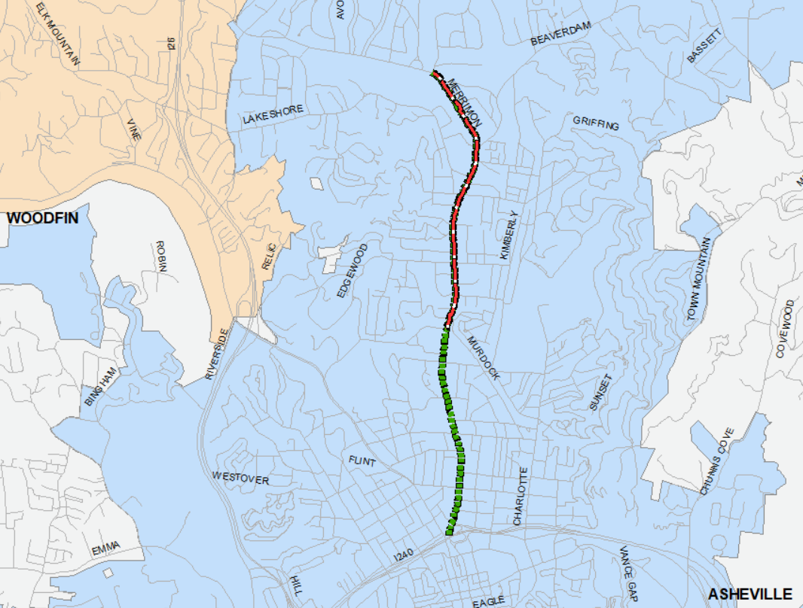
General Summary
Proposed Road Diet Through Resurfacing
MTP Road Diet Project
NCDOT plans to resurface US 25 from Southside Avenue to Midland Drive in 2022
Implementing a road diet from WT Weaver Boulevard to Wembley Drive (current end of the four-lane cross-section) is being considered as part of the resurfacing project

Slide 3
Complete Streets
Initially adopted in 2012 and further refined in 2019:
“The purpose of this policy is to guide existing decision making and design processes to ensure that all users are included during the planning, design, construction, funding, operation and maintenance of North Carolina’s transportation network, and will not create barriers or hazards to the movements of those users.”

Slide 4
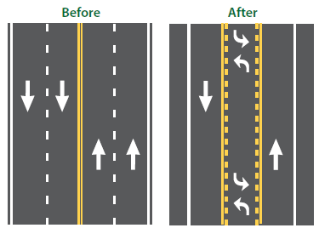
Road Diet Benefits
FHWA Proven Safety Countermeasure
19-47% reduction in total crashes
Reduction of rear-end and left-turn crashes due to the dedicated left-turn lane
Reduced right-angle crashes
Fewer lanes for pedestrians to cross
Opportunity to add bike lanes, parking, additional pedestrian space
More consistent speeds
Typically implemented on roads with 25,000 AADT or less

Slide 5
Context
Safety
31 recorded bicycle and pedestrian crashes
150% crash rate of similar roadway segments
Volumes
NOTE: volumes about 12-18% higher in 2019
North of WT Weaver (2020)
11,500-20,000
South of WT Weaver (2020)
18,500-21,000

Slide 6
Context
Several Intersections on Merrimon with safety issues identified in NCDOT HSIP reports between 2017-2021
Just north of Beaverdam
Ottari Road
Maney Avenue
Edgewood Road
Westall Drive
Murdock Avenue
Coleman Avenue
Hillside Drive
Woodrow Avenue
Merrimon Drive

Slide 7
Context
Walkable context suggests latent demand
FBRMPO Congestion Management Process
EPA Smart Location Database

Slide 8
Planning Background

Slide 9
Planning Background
2045 Metropolitan Transportation Plan

Slide 10
Planning Background
Congestion Management Process

Slide 11
Planning Background
Two intersection projects funded in P 3.0 were defunded in 2020
Initially proposed five-lane cross-section between WT Weaver and Edgewood on Merrimon
Negative public feedback at meetings in 2018

Slide 12
Considerations
Can a road diet on Merrimon work without immediate improvements to intersections and other improvements?

