Slide 1
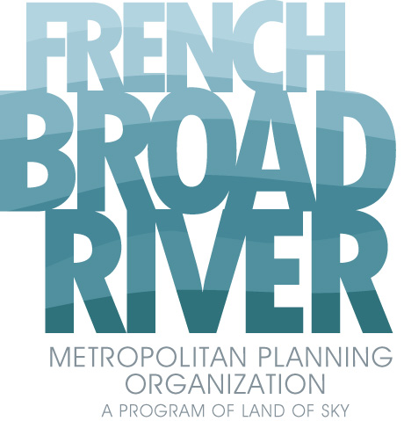
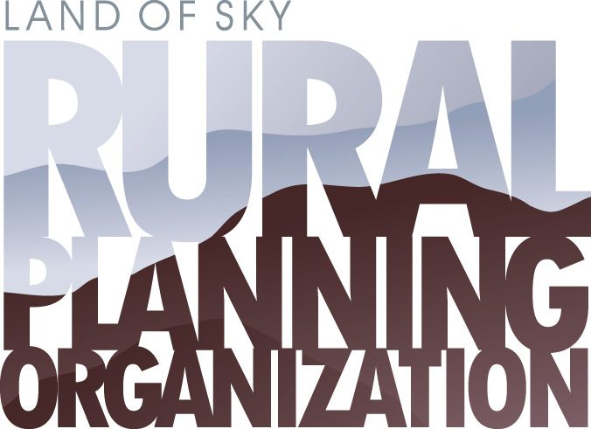
Transportation Design for Wildlife Crossings
Scott Adams, AICP Transportation Planner French Broad River MPO
September 21, 2023

Slide 2
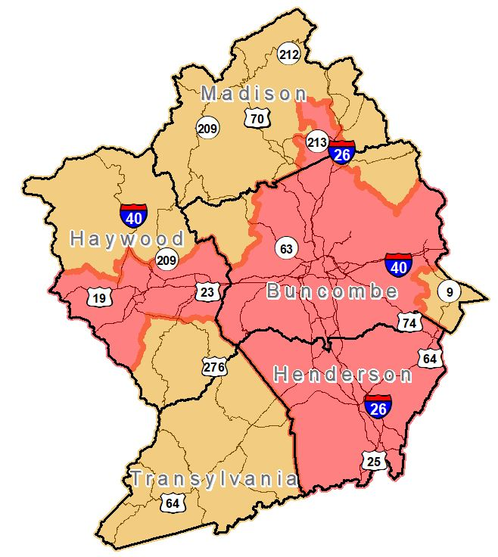
Who We Are
The MPO & RPO carry out the Federal transportation planning process with local governments, NCDOT, and other partners.
The process is focused on being:
Comprehensive
Cooperative
Continuous
1
Notes:
MPO in red, RPO in orange.

Slide 3
What We Do
Life of a Transportation Project
CTP
30+ Years
No $ Constraint
MTP
25 Years, Used for AQ Determinations
Based on Revenue Forecast
SPOT
Scores Projects for Effectiveness
Results go into STIP/TIP
STIP/TIP
0-5 and 6-10 Years
Specific Funding Sources Identified
Construction
Project Let, Built
NEPA/Design
Project alternatives are assessed
Final project design and cost
2040 Plan
Statewide Vision
Strategic Corridors
State
State
All phases are important, but these are key.
Feds
State
Feds
2
Notes:
NCDOT Strategic Prioritization Office of Transportation (SPOT)

Slide 4
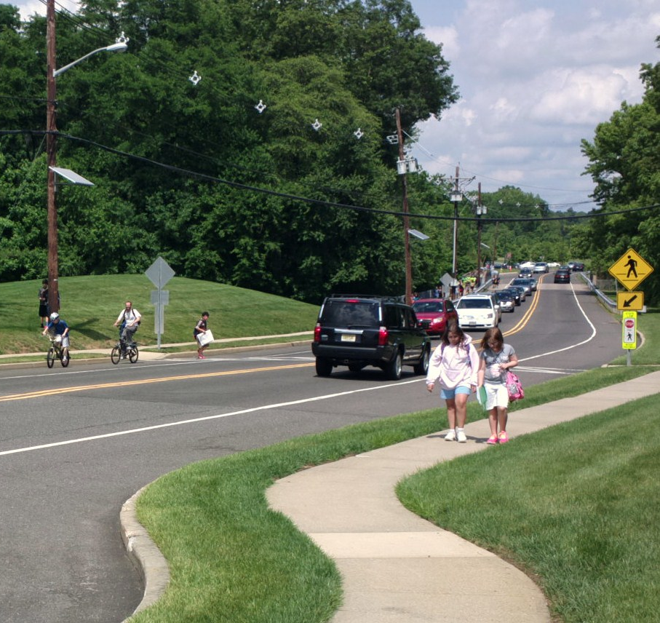
Why Is This Important?
NCDOT Complete Streets Policy
Three main reasons people care about this issue:
Interest in wildlife conservation
Concern for human safety
Economics
“No matter who you are, where you live, or what you do for a living, you’re going to care about at least one of these.” Marcel Huijser, Senior Research Ecologist Western Transportation Institute Montana State University (Bozeman) 20 years of road ecology studies
Additional framework for
Routine Accommodation
“Routine Accommodation” can occur via:
Resurfacing
Maintenance
New construction
3
Notes:
NCDOT Complete Streets
Policy Exceptions
Unique site constraints
Distance from existing/planned facilities
Bike/Peds prohibited
No existing/planned transit service
Evaluated by Complete Streets Review Team
Policy Exceptions
Unique site constraints
Distance from existing/planned facilities
Bike/Peds prohibited
No existing/planned transit service
Evaluated by Complete Streets Review Team

Slide 5
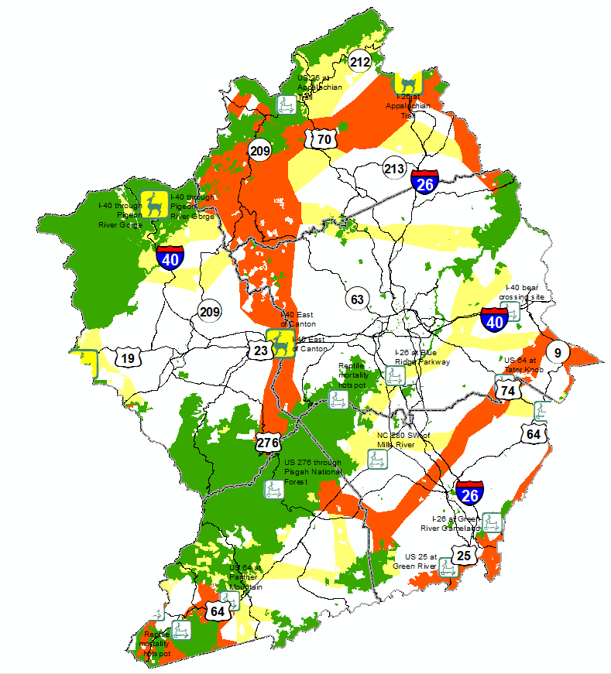
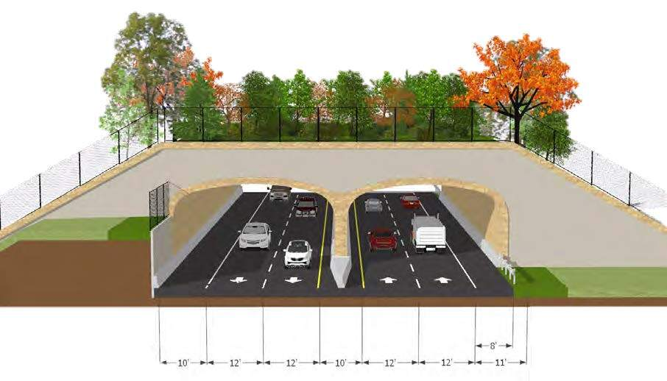
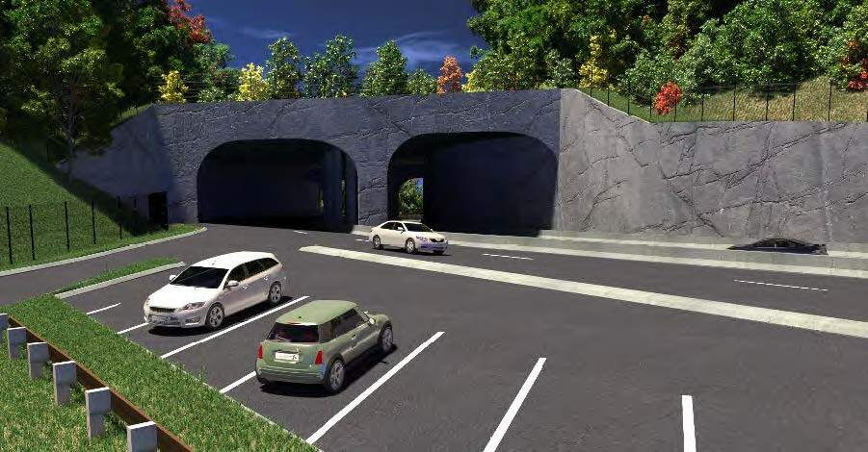
Definitions
Notes from Ron Sutherland, Chief Scientist, Wildlands Network
“A wildlife corridor is the term we use for a defined movement pathway that, if protected or restored, would provide essential habitat connectivity for one or more species,” he says.
“A wildlife road crossing, on the other hand, is “a structure that is designed to allow wildlife to safely cross over or under a busy road,” he says.
4
Notes:
Stecoah Gap Overpass, on NC 143, just west of Andrews, NC

Slide 6
Why Now?
The Numbers:
Wildlife Vehicle Crash (WVCs) impacts to wildlife and humans alike via injuries and deaths.
WVCs are costly, and preventative measures are a good investment.
There’s money available to address the issue via the IIJA/BIL’s Wildlife Crossings Pilot Program (WCPP).
5
Notes:
The Bipartisan Infrastructure Law, as enacted in the Infrastructure Investment and Jobs Act,

Slide 7
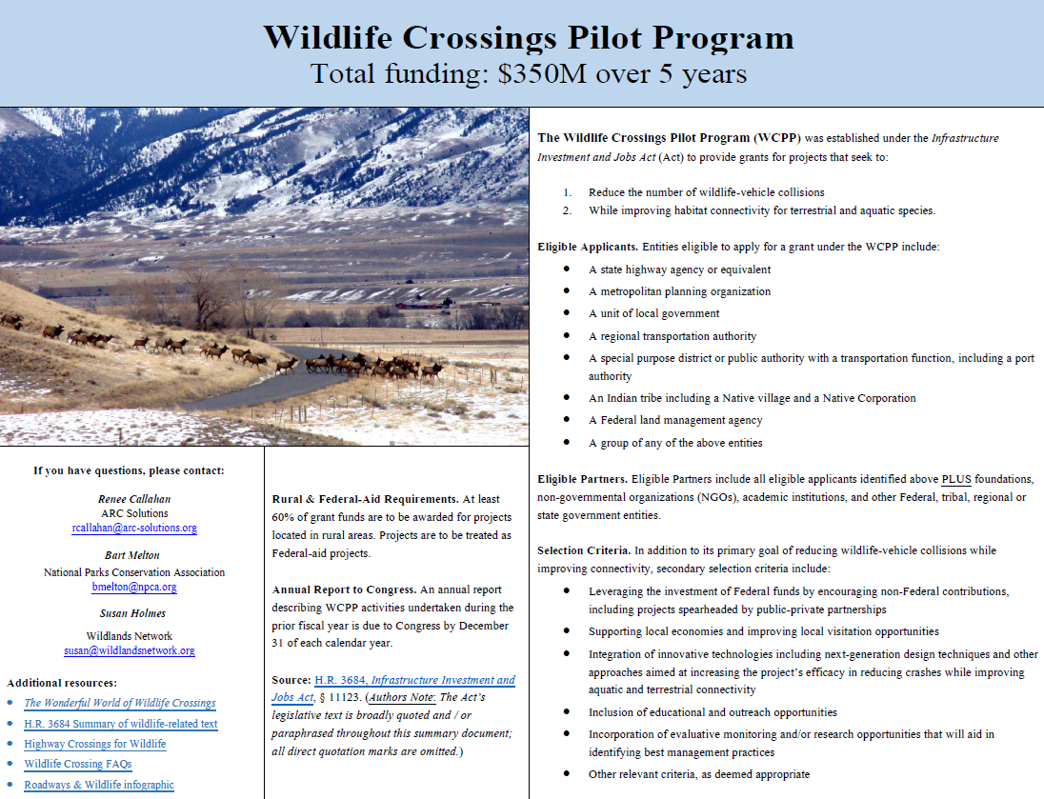
Source: Animal Road Crossing (ARC),
https://arc-solutions.org/wp-content/uploads/2021/11/Wildlife-Crossings-Pilot-Program-Summary.pdf
6

Slide 8
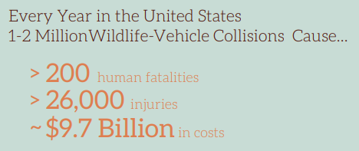
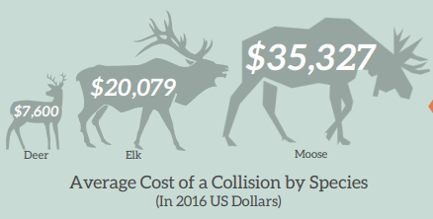
Roads & Wildlife in USA
Source: Animal Road Crossing (ARC),
https://arc-solutions.org/wp-content/uploads/2021/11/ARC-CLLC-Roads-Infographic.pdf
7

Slide 9
Roads & Wildlife in NC
2017-2019
56,868 wildlife-vehicle collisions (WVCs)
$156.9 million in property damage
2,800+ human injuries
5 human fatalities
Source: NCDOT Transportation & Safety Division Study – June 2020
8

Slide 10
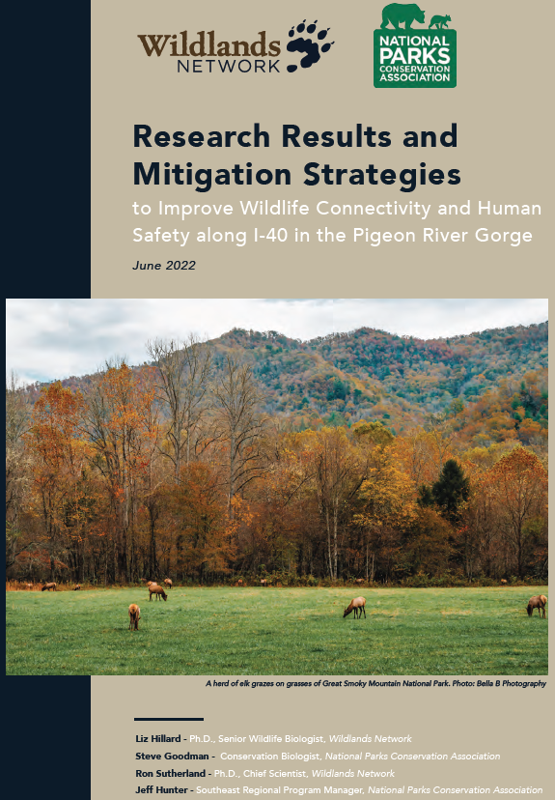
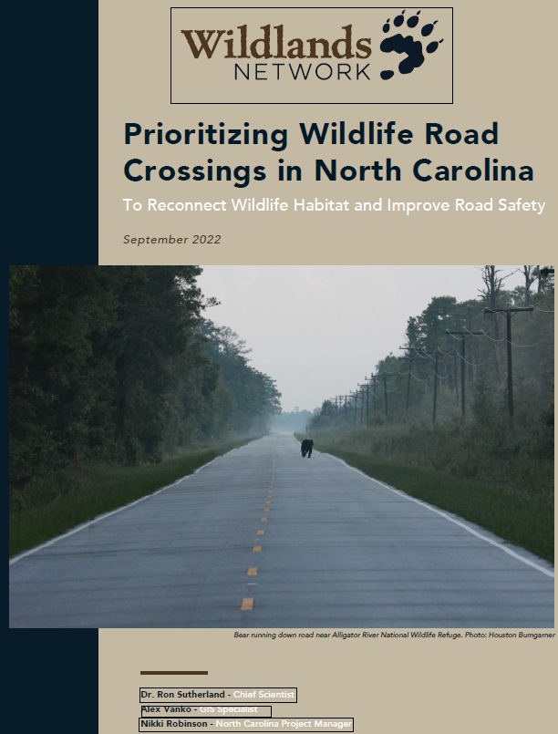
Recent NC Studies
9

Slide 11
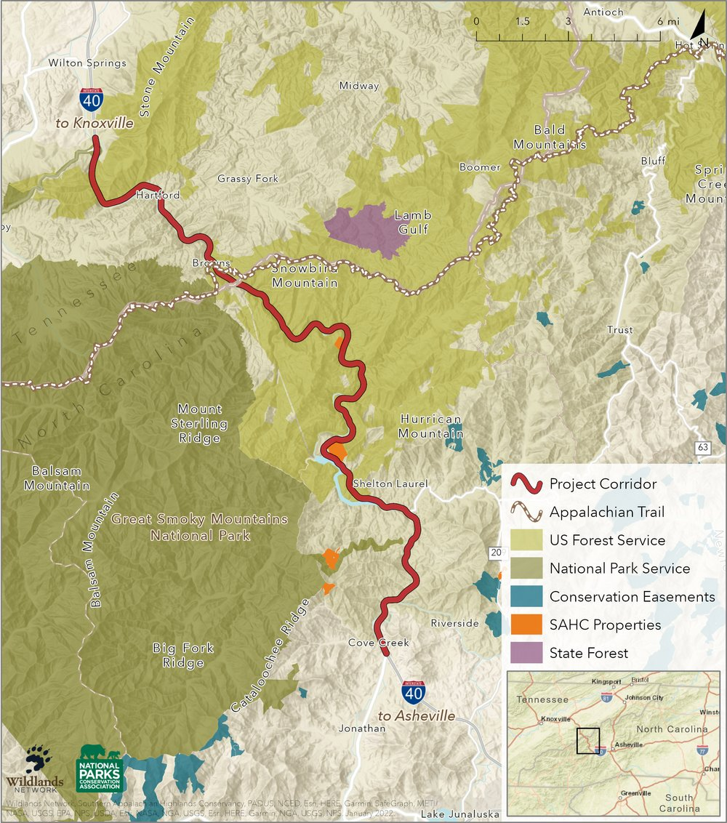
Pigeon River Gorge Study
Study identified 20 sites:
13 sites in NC (4 High-Priority sites)
7 sites in TN (3 High-Priority sites)
NOTE: 120 cameras over 28 miles (I-40 Pigeon River Gorge Wildlife Crossing Project)
10

Slide 12
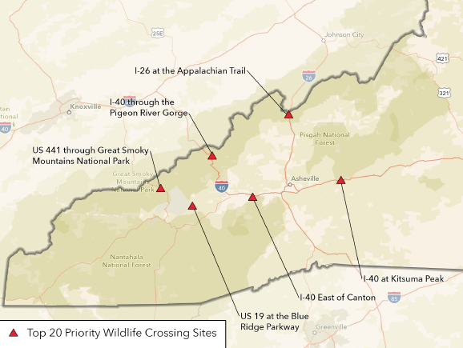
NC Statewide Study
On road segments with 5 deer-vehicle collisions or 2 elk-vehicle collisions per mile per year, the cost of collisions exceed the cost of wildlife crossing structures, notably Deflection Fencing.
Avg. deer-vehicle collision cost: $6,000
Avg. elk-vehicle collision cost: $17,000
The statewide study identified 155 wildlife crossing priority sites across NC, including Top 20 Sites. (5 in Land of Sky region)
11
Notes:
Source: pg. 7, of report cited on-screen
“Collision-related costs add up to roughly $12 billion annually in the U.S.,” he says. “The cost of a deer–vehicle collision averages around $6,000 and running into an elk can cost upwards of $17,000.”
Wildlife crossing structures and road mitigation have improved human safety and wildlife corridor connectivity at Snoqualmie Pass on I-90 in Washington State, along the Trans-Canada Highway in the Rocky Mountains and Banff National Park, and on the Flathead Indian Reservation in Western Montana where Huijser worked for 13 years. In these examples, fencing successfully reduces collisions and guides wildlife to safe-crossing opportunities such as vegetated overpasses, open-span bridges, and large- and medium-mammal underpasses. Dozens of such wildlife corridor projects have led to an 80–95 percent collision reduction with large mammals like deer and elk since the mid-’90s.

Slide 13
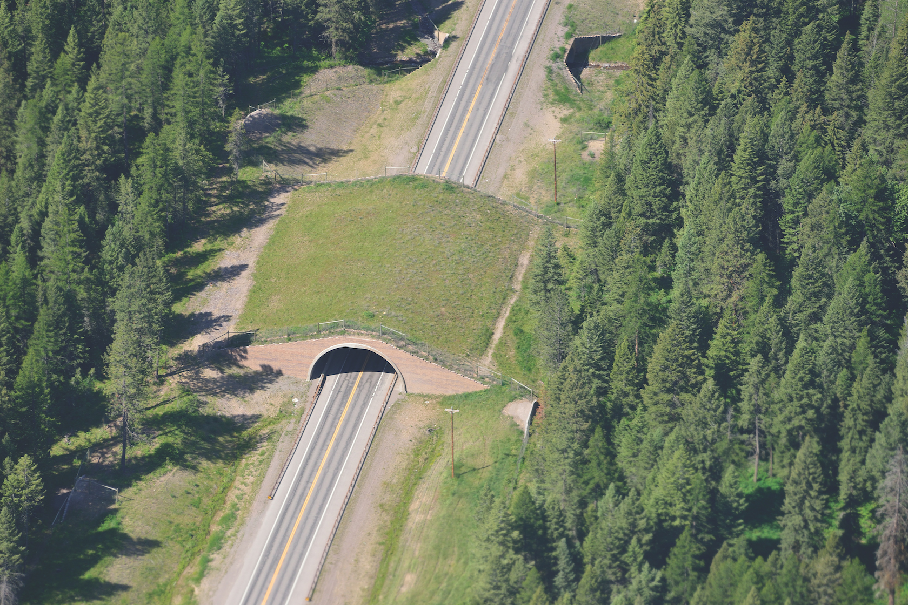
Types of Crossings
Signs (static)
Interactive Signs
Round Culverts
Box Culverts
Multi-Plate Arches
Open-Span Bridges
Bridge Extensions
Wildlife Underpasses/Overpasses
Deflection
Fencing
Photo by Marcel Huijser
Ideally, a combination of various crossing types—like a buffet of choices—should be provided, spaced out in such a way that animals do not need to travel great distances to find a crossing opportunity.
12
Notes:
Source: text and photos from https://appvoices.org/2021/03/18/i40-wildlife-connectivity/
Although road mitigation measures are good for human safety and for animals, they cost money. Fences may cost about $100,000 per mile, an underpass may require around half a million to build, and a single wildlife overpass can cost up to $10 million.

Slide 14
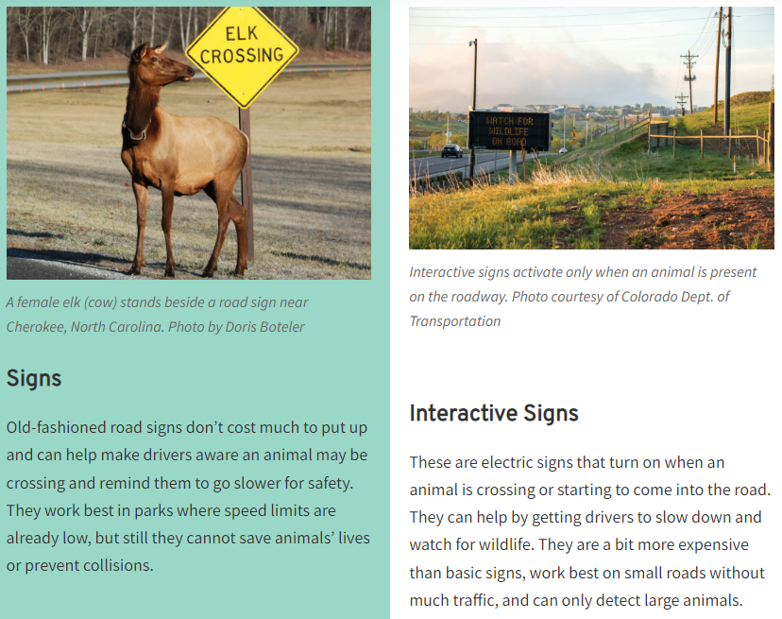
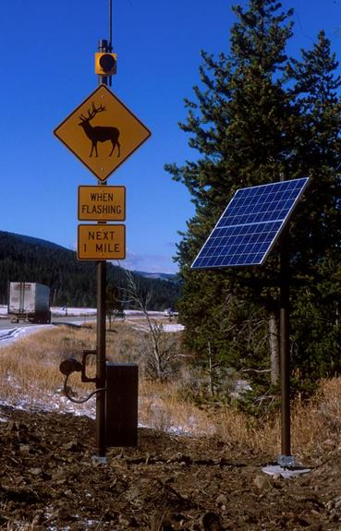
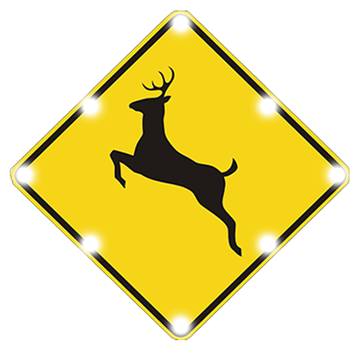
Signs
US 191 in Yellowstone N.P.
13

Slide 15
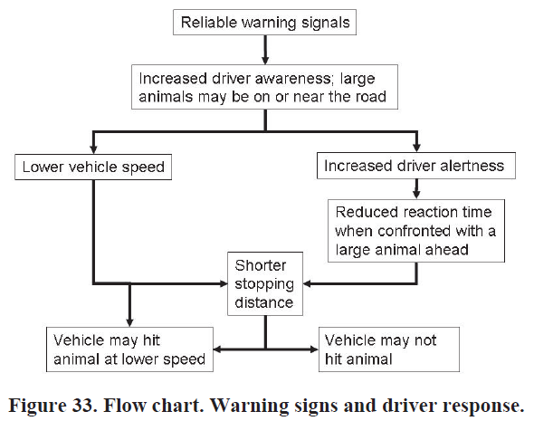
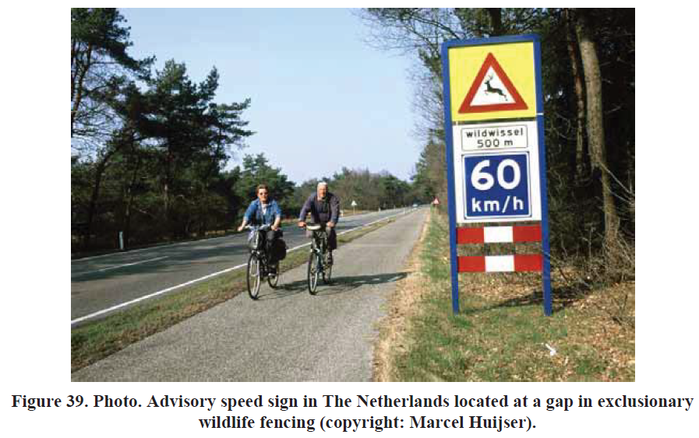
Signs
Perception-reaction time is key.
14
Notes:
The Netherlands is slightly larger than the state of Maryland.

Slide 16
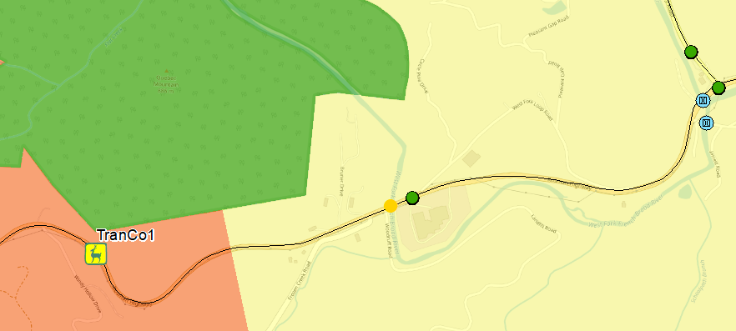
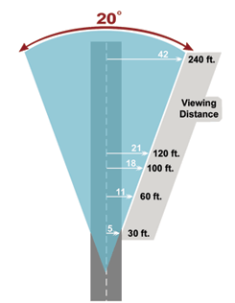
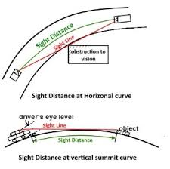
Signs/Fencing example, US 64 at Panther Mtn.
Wildlife travel path
Deflection Fencing
15

Slide 17
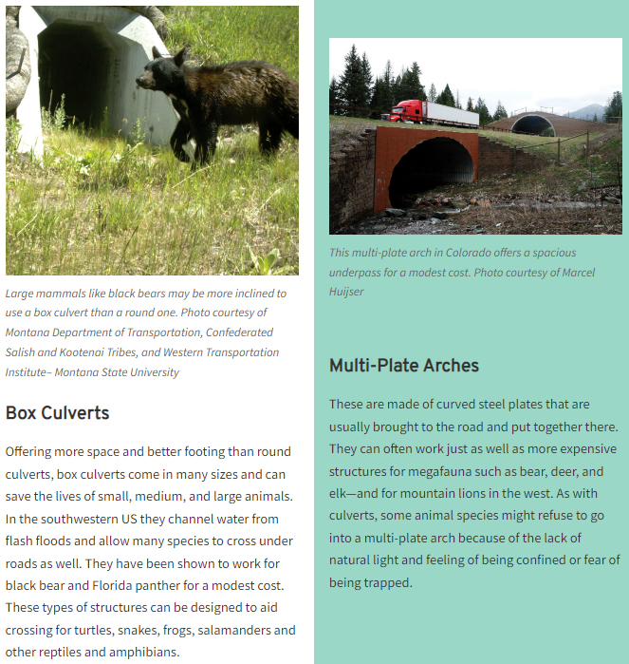
Underpasses
NOTE: Natural-bottomed culverts are more effective at supporting aquatic species
16

Slide 18
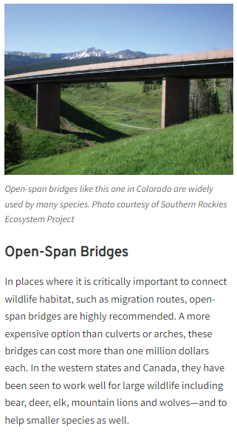
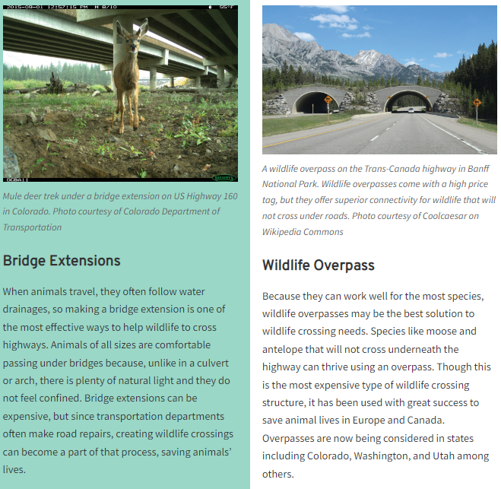
Bridges & Overpasses
NOTE: Daylight and natural vegetation-screening are key to increasing wildlife’s degree of comfort with constructed structures; if an animal cannot see daylight, they may feel confined or like the structure’s a trap.
17

Slide 19
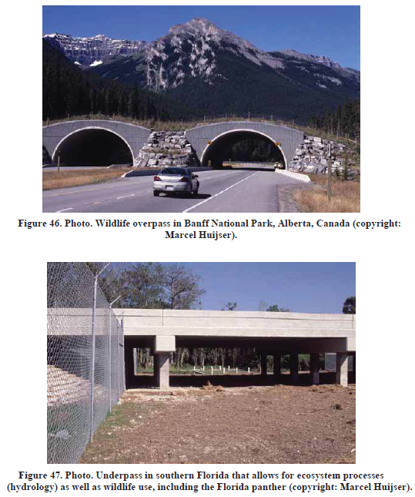
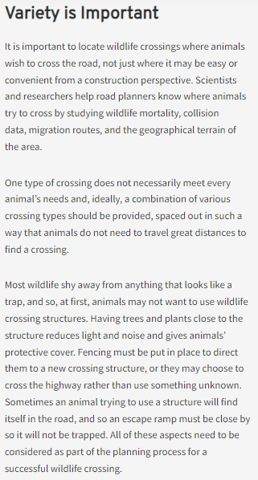
Bridges & Overpasses
NOTE: Structures can be designed to achieve multi-functionality – i.e. wildlife crossing and hydrology, etc.
18

Slide 20
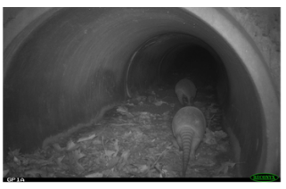
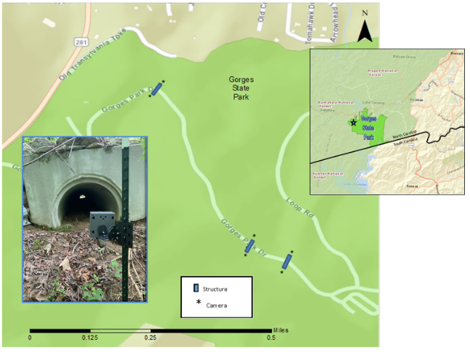
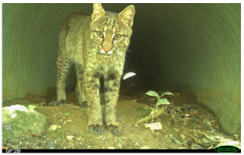
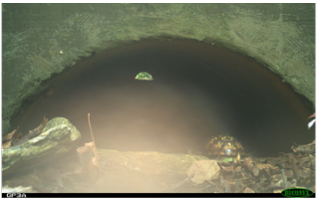
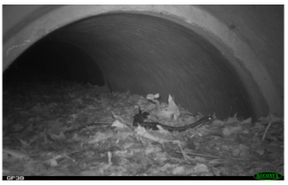
Not Just Big Critters
Source: Wildlands Network
https://wildlandsnetwork.org/news/monitoring-crossing-structures-reveals-timber-rattlesnakes
19
Notes:
https://wildlandsnetwork.org/news/monitoring-crossing-structures-reveals-timber-rattlesnakes

Slide 21
So What Works?
Source: Animal Road Crossing (ARC),
https://arc-solutions.org/wp-content/uploads/2021/11/ARC-CLLC-Roads-Infographic.pdf
20

Slide 22
The Details
21

Slide 23
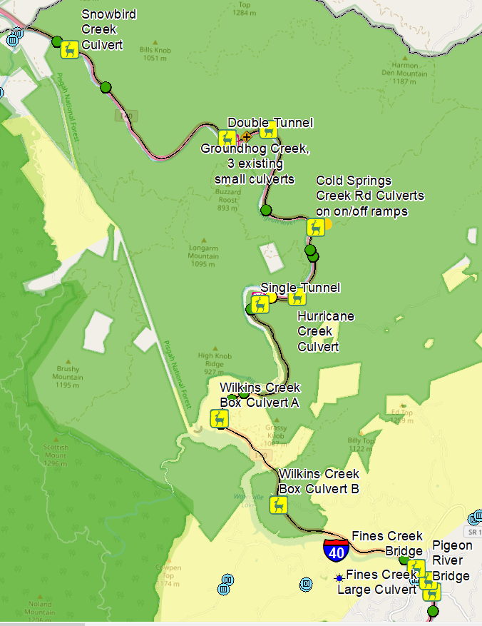
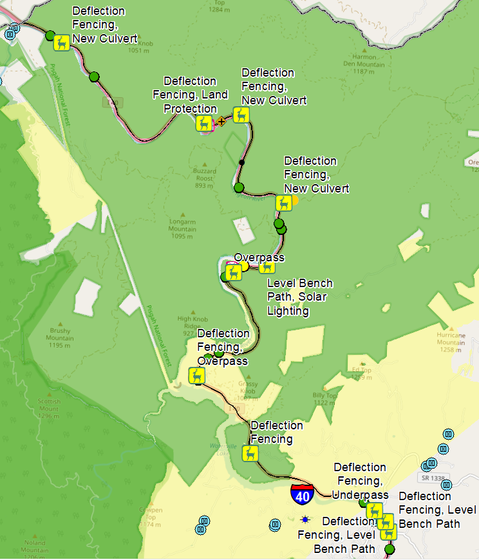
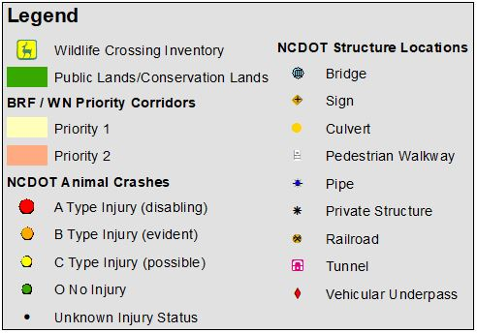
The Details
22

Slide 24
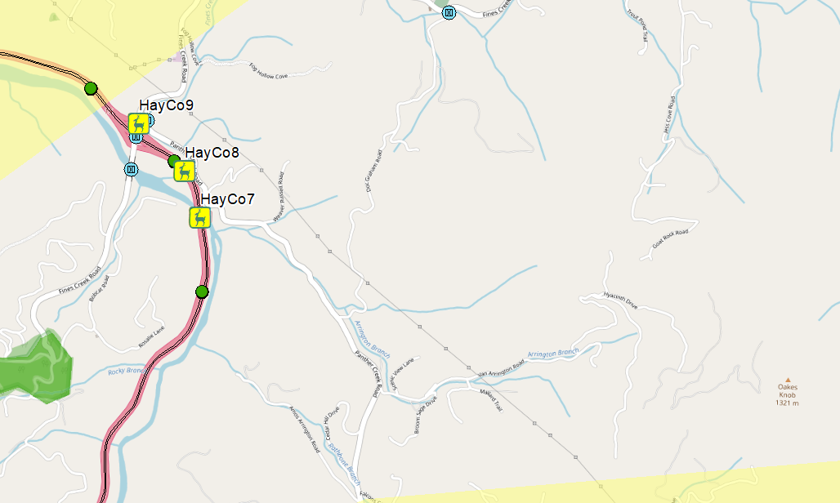
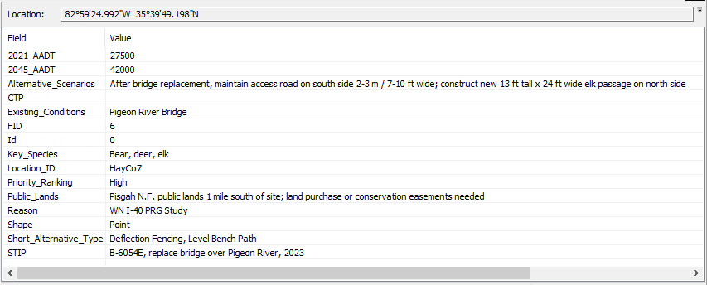
The Details
23

Slide 25
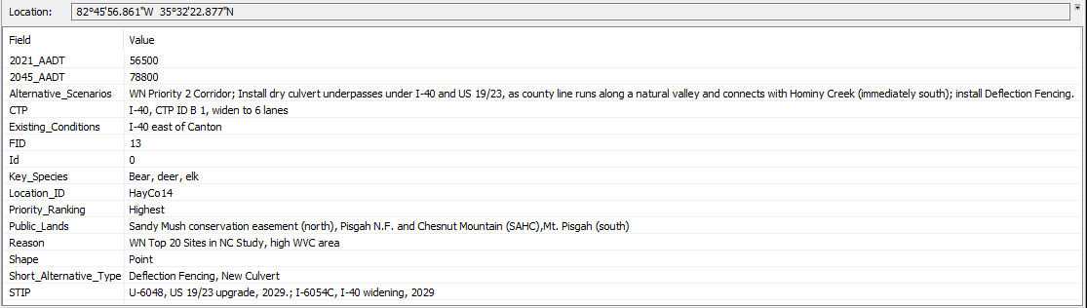
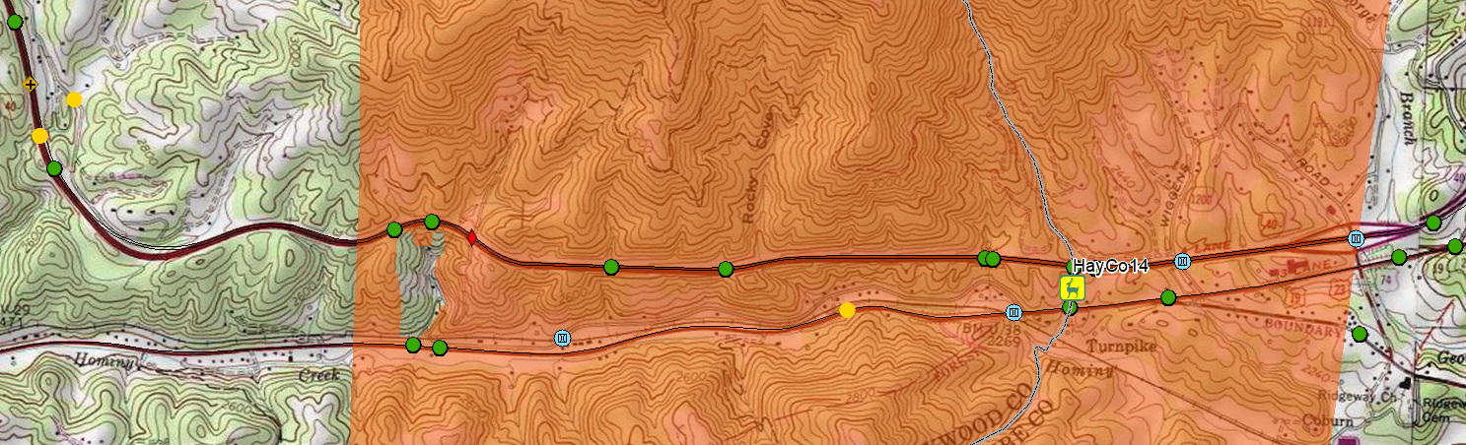
The Details
TRIPLE 8'X11'RCBC;439’
ALONG CENTERLINE CULVERT
SINGLE 18'X14' VEHICULAR UNDERPASS;
127' ALONG CENTERLINE
TRIPLE 12'X13' RCBC;
101' ALONG CENTERLINE CULVERT
24

Slide 26
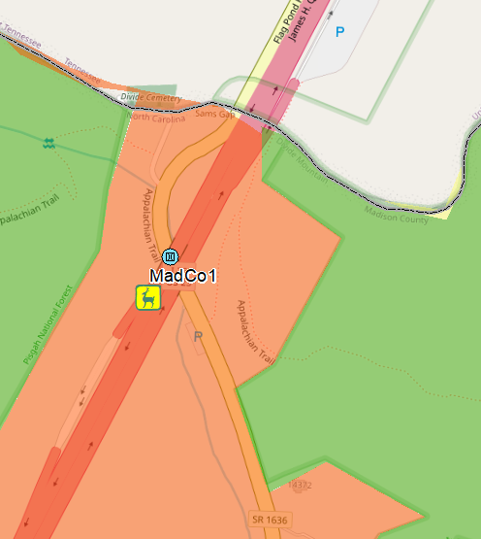
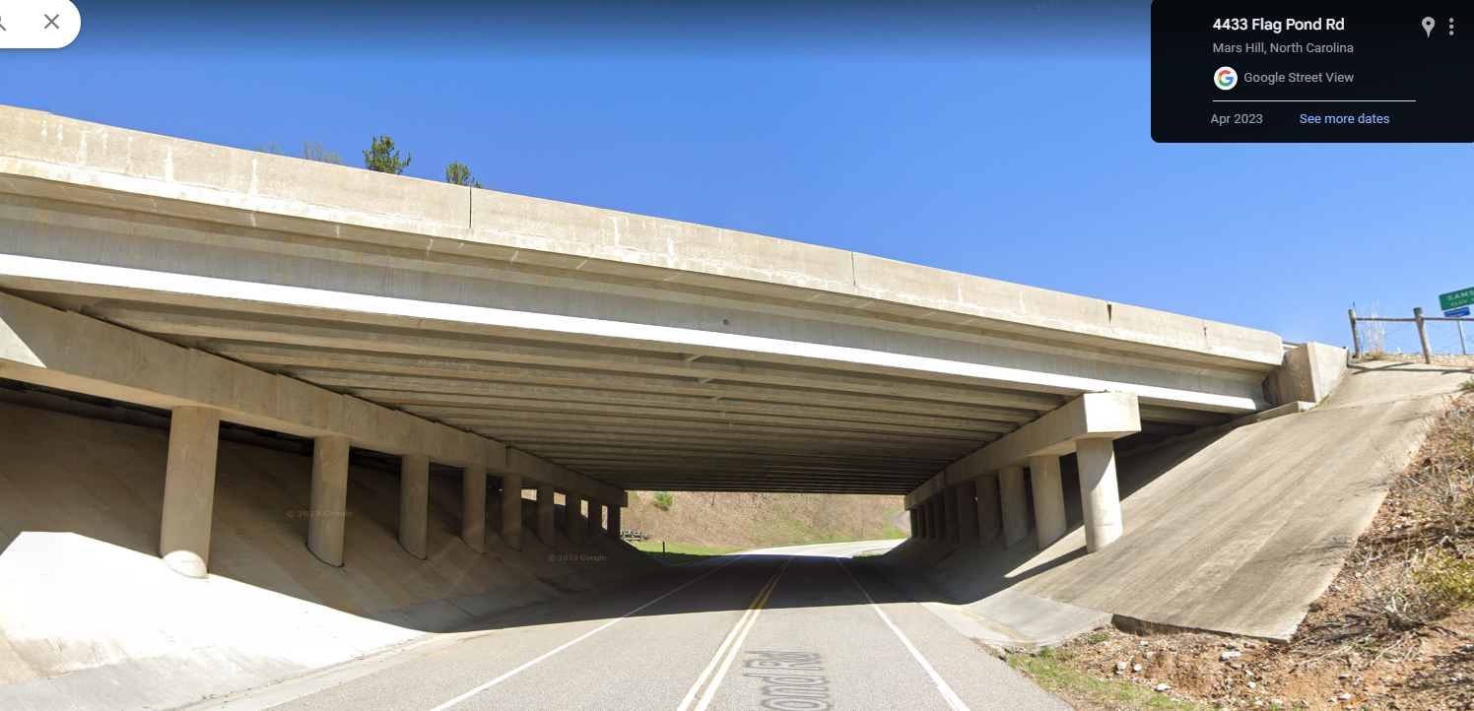
The Details
9/21/23, Steve Goodman, NPCA:
Remove the concrete ditch swale on one or both sides and truncate the abutment slope by introducing a vertical retaining wall just in front of the piers. Consider standalone combined wildlife and AT structure.
24

Slide 27
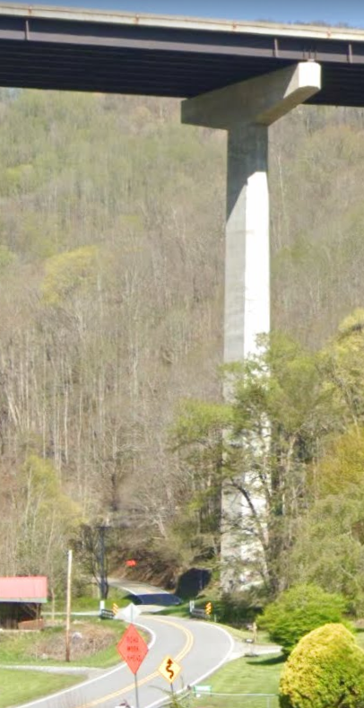
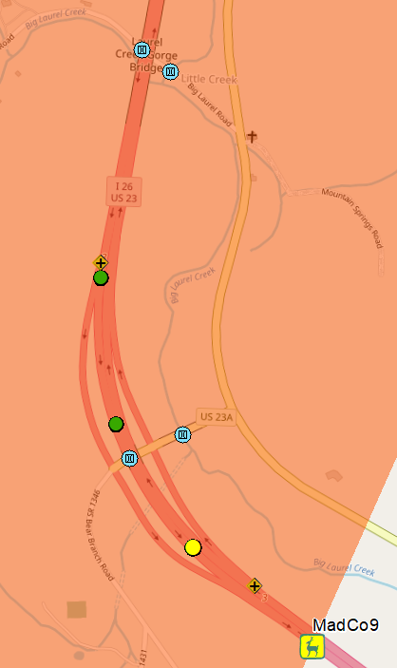
The Details
Big Laurel Bridge
Wolf Laurel Exit Bridge
Big Laurel Bridge
Wolf Laurel Exit Bridge
9/21/23, Steve Goodman, NPCA:
Wolf Laurel Exit Bridge: Truncate the abutment slope by introducing a vertical retaining wall just in front of the piers. Big Laurel Bridge: add level bench paths.
24

Slide 28
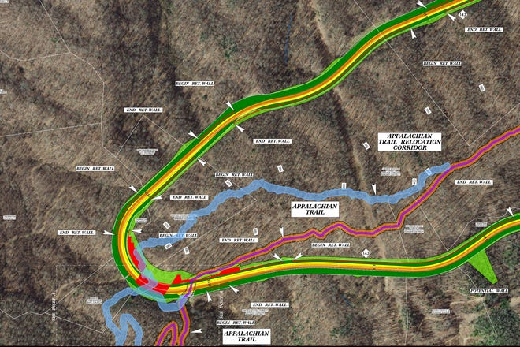
NCDOT – Stecoah Gap Overpass
25

Slide 29
Thank You!

