Slide 1

5307 Sub-Recipient Update re: Census 2020
French Broad River MPO
September 21, 2023

Slide 2
Overview
UZAs >200,000 pop.
Section 5307 funds are allocated to FTA‐defined Urbanized Area (UZA) Designated Recipients; City of Asheville is current Designated Recipient.
UZA Designated Recipients receive FTA formula‐based allocations and equitably suballocate funds to operators within each UZA.
In UZAs in which the MPO is not the designated recipient, the MPO must still determine the intra‐UZA funding sub‐allocation.
UZAs 50,000 – 199,999 pop.
The state of North Carolina receives and distributes Section 5307 funds for UZAs with a population less than 200,000 people.
Notes:
It’s coming to the region (i.e. the MPO), but the Designated Recipient has to follow the agreed-upon allocation formula.

Slide 3










Overview
FTA 5307 Funding Model
for Urbanized Areas (UZA) >200,000
Sub-Recipients
28.6%
The MPO:
Determines 5307 percentage allocation to Recipient and
Sub-Recipients based on formula
Holds a Call for Projects on JARC funding (10% of 5307 funds)
Designated Recipient
42.6%
20.4%
$4.08 million to UZA
NOTE: Haywood County is phasing out of 5307 eligibility with FY 2024
(Oct. 1, 2023 – Sept. 30, 2024) due to U.S. Census Urbanized Area changes.
The county may become 5307 eligible again depending on Census 2030.
8.3%

Slide 4
Overview
In 2017, the French Broad River MPO and its 5307 transit partners agreed on a funding formula based on Census Urbanized Areas (UZA) as follows:
  Alternative 9 (of Allocation Alternatives)
  FTA Section 5307 Apportionment Formula without Revenue Miles
    Non-incentive bus portion tier – 90.8 percent
      50 percent apportioned based on population
      50 percent apportioned based on population X population density
    Incentive bus portion tier – 9.2 percent
      Bus passenger miles X bus passenger miles/operating cost
2020 Census Urbanized Areas were finalized and published Jan. 9, 2023.
Asheville UZA decreased size per 2020 UZA methodology (“jump” distance), resulting in new Haywood County UZA’s and transit funding changes.
Notes:
This was done because revenue miles for demand response service versus fixed route service is often calculated differently. Demand response revenue miles is calculated as soon as the vehicle leaves the bus yard to its first pick up. Fixed route service does not start calculating revenue miles until it goes into service at its first stop, until then this is considered deadhead miles.

Slide 5
Urbanized Area (UZA)
2020

Slide 6
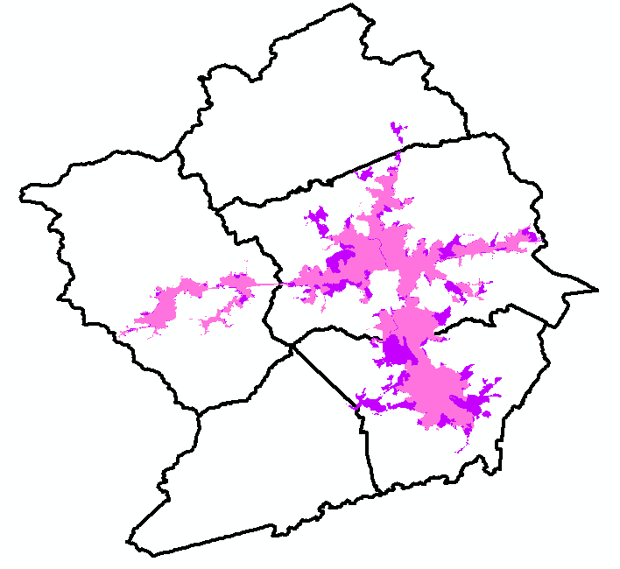
Federal Basis-Urbanized Area (UZA)
a densely settled core of census tracts and/or census blocks that meet minimum population density requirements,
along with adjacent territory containing non-residential urban land uses
as well as territory with low population density included to link outlying densely settled territory with the densely settled core.

Slide 7
More on UZA
The French Broad River MPO did not draw these boundaries. They are done by the US Bureau of the Census, and the MPO is bound to do transportation planning for those areas per 23 USC § 134(e)(2)(A):
(2) Included area.— Each metropolitan planning area—
(A) shall encompass at least the existing urbanized area and the contiguous area expected to become urbanized within a 20-year forecast period for the transportation plan

Slide 8
The Negotiable Part That Matters:
The Metropolitan Planning Area
In addition to the Census-designated UZA, the MPO is bound to do transportation planning for additional areas per 23 USC § 134(e)(2)(A):
(2) Included area.— Each metropolitan planning area—
(A) shall encompass at least the existing urbanized area and the contiguous area expected to become urbanized within a 20-year forecast period for the transportation plan

Slide 9
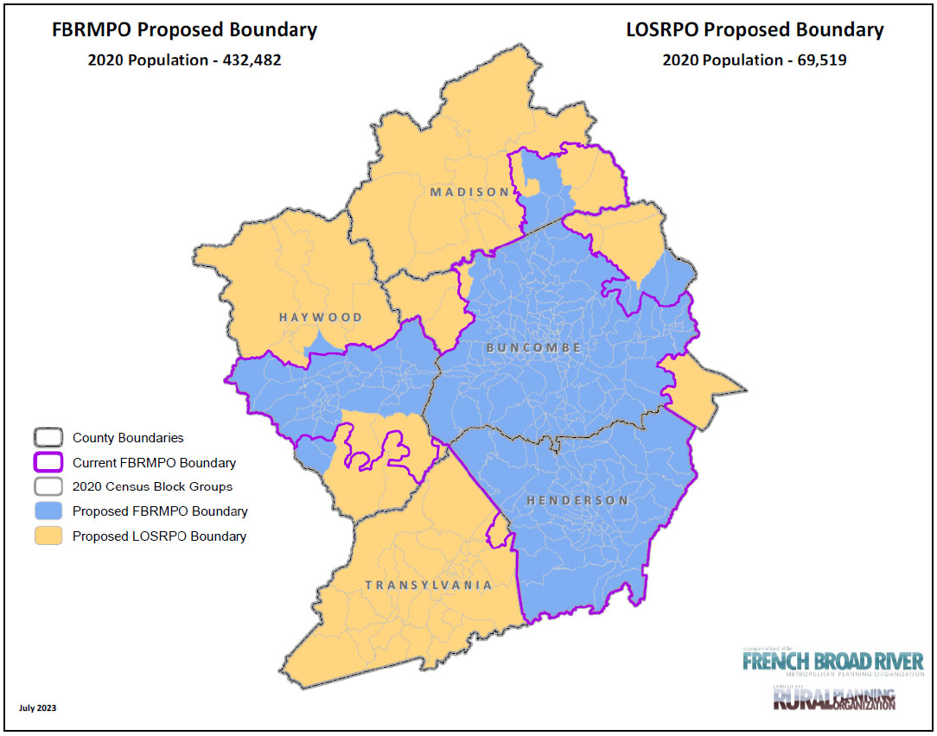
MPO Planning Boundary Update 8/17/23
Notes:
The small, light-blue geographies are U.S. Census Block Groups, which were used as the unit of analysis for updating the MPO/RPO Planning Area boundaries. The previous boundaries were drawn partly based on watersheds (see old boundary lines in southern Haywood County), but these did not align with any U.S. Census geographies (i.e. Census Tracts, Census Blocks, Census Block Groups), creating difficulties for demographic analysis needed.

Slide 10
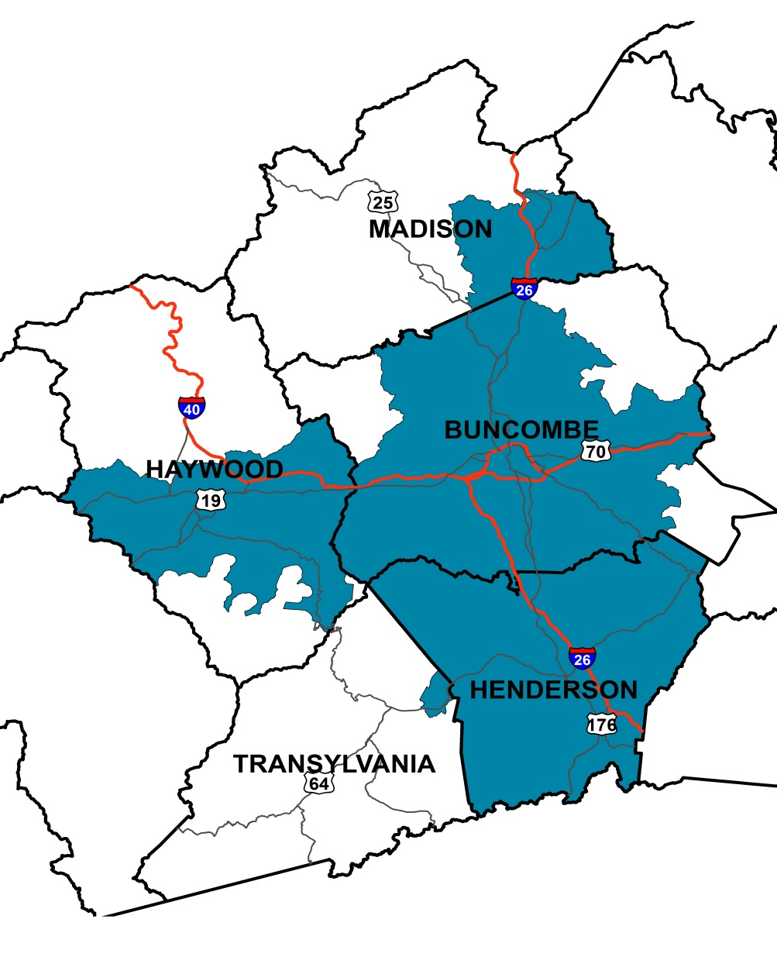
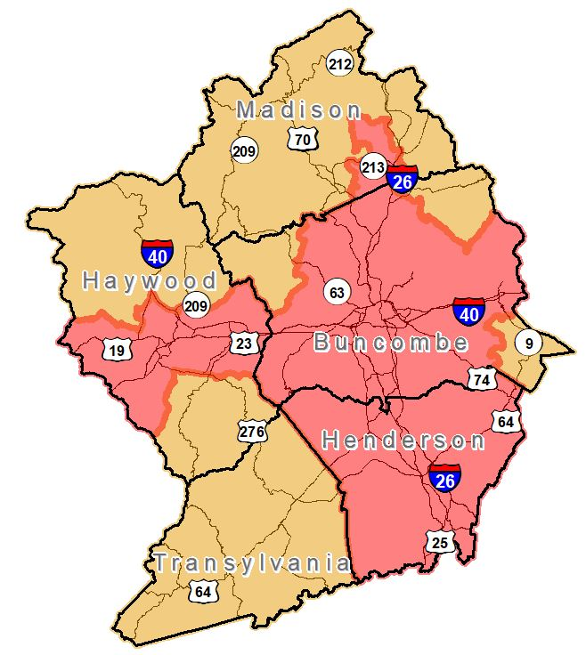
The French Broad River MPO
Previous MPO Boundary (blue-green)
Current (8/17/23) MPO Boundary (red)
Began in 60s
Centered around Asheville
Grew to include Henderson & Haywood in 2000, Madison in 2010

Slide 11
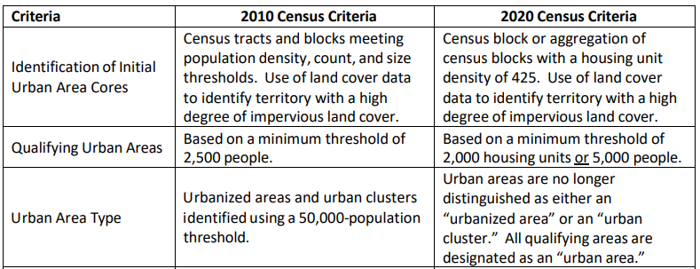
Changes to the 2020 Urbanized Area Criteria

Slide 12
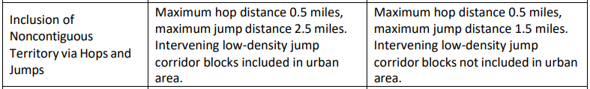
Changes to the 2020 Urbanized Area Criteria

Slide 13
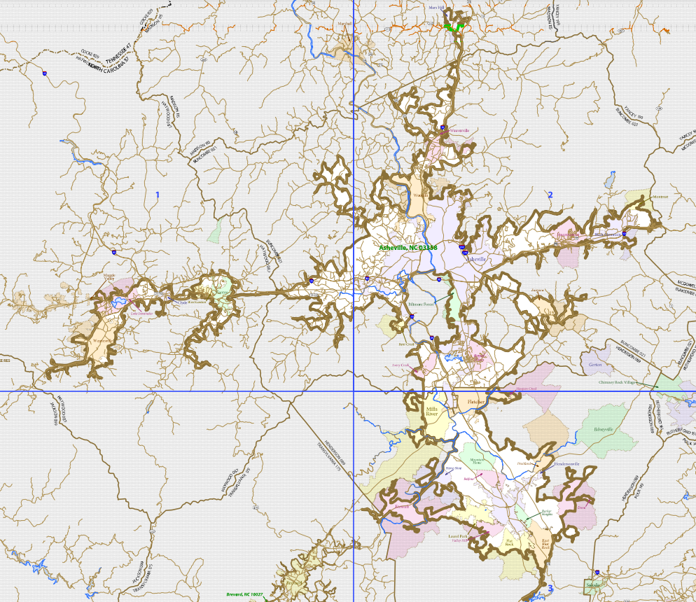
Brevard UZC
2010 UZA map
Notes:
Brevard Urbanized “Cluster” – term no longer used as of 2020 Census, all “Urbanized Areas” now

Slide 14
Waynesville UZA
24,285 Pop.
Canton UZA
8,812 Pop.
2020 UZA
populations
Brevard UZA
13,059 Pop.
2010 UZA map

Slide 15
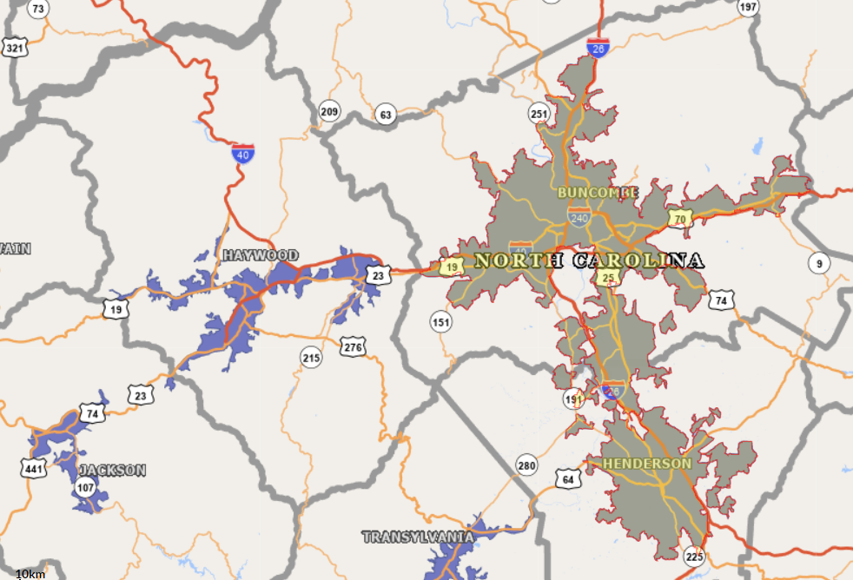
Urban Area Maps
https://tigerweb.geo.census.gov/tigerweb/

Slide 16
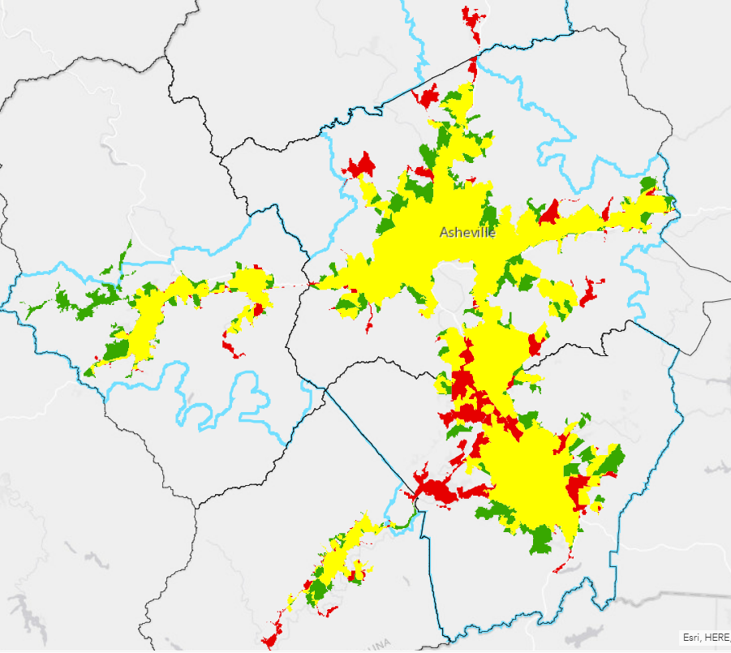
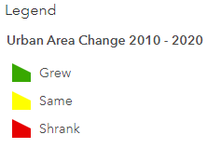
Changes in the Urban Areas
https://www.arcgis.com/home/webmap/viewer.html?webmap=bd0e7dcb4bf44f8694e1f100bc044ff9&extent=-83.7275,35.0026,-81.6992,36.0964

Slide 17
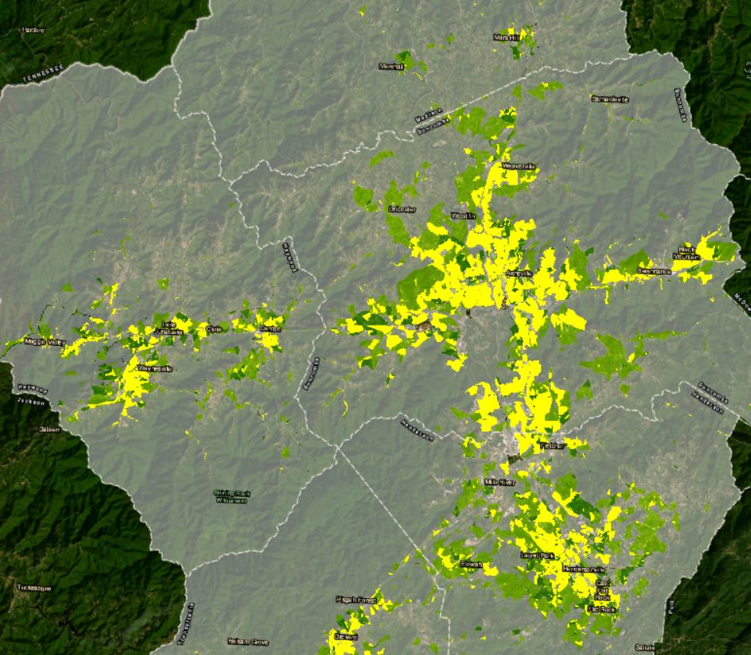
Where Urbanization is Expected in the Next 20 Years (MPO Projections)

Slide 18
Asheville UZA
Urban population per US Census
Form P2: 2020 DEC Demographic and Housing Characteristics
2.35% increase in urbanized population

Slide 19
Transit Funding Changes - Summary
Haywood County
  County’s UZAs have less than 50,000 population, therefore they’re not eligible for 5307 urban funding. Instead, they’re eligible for 5311 rural funding. Haywood County will be a sub-recipient of NCDOT rather than the City of Asheville.
City of Asheville, Buncombe and Henderson County
  Local percent allocations increase; funding levels unknown at this time.

Slide 20
Transit Funding Options
Option 1
  Continue with the existing funding formula (i.e. Alternative #9), updated with new
  Census UZA numbers, starting in FY 2024.
Option 2
  Review previous funding formula study Alternatives (#1-9) and choose one of these as the new formula starting in FY 2024.
Option 3
  Start an entirely new funding formula study
  (NOTE: Previous study used MPO Planning Funds (80%) and local matching funds (20%; each local funding contribution based on population % within MPO).
Notes:
1/28/16 MPO Board Meeting: Transit 5307 Allocation and Eligibility Study; $56,482 PL funds, $14,120 local funds, total: $70,603

Slide 21
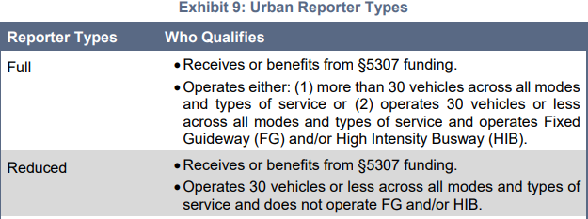
9/12/23 5307 Sub-Recipient Work Group Discussion
For FY 2024 (Oct. 1, 2023 – Sept. 30, 2024), the group agreed to continue using Alt. #9 formula (minus Haywood County).
For FY 2025 (Oct. 1, 2024 – Sept. 30, 2025), the group would like to explore using more uniform datasets from the National Transit Database (NTD) that are available for City of Asheville (Full Reporter), Buncombe County (Full Reporter), and Henderson County (Reduced Reporter). e.g. FTA Form FFA 10
For FY 2025, the group is interested in looking at the “total funding picture”
(i.e. City of Asheville additional local funds dedicated from local general fund, SMAP and ROAP funds available to Buncombe County, etc.)
Fixed Guideway = dedicated R.O.W. for transit, may include rails or overhead catenary
High Intensity Busway = dedicated bus lane
Notes:
NCDOT transit funding programs
State Maintenance Assistance Program (SMAP)
Rural Operating Assistance Program (ROAP)

Slide 22
QUESTIONS?

Slide 23
Additional Background Information
Pages with yellow-highlighted sections are from the 2017 FBRMPO Urban Transit Funding Formula Study (i.e. 5307 study), KFH Group
Red callout notes/comments are by Scott Adams, Transportation Planner, FBRMPO
On slide #27, calculations were only run for Alt. #1 and Alt. #9 for the purposes of this presentation since those were the two Alternatives favored by the FBRMPO Board in 2017.

Slide 24
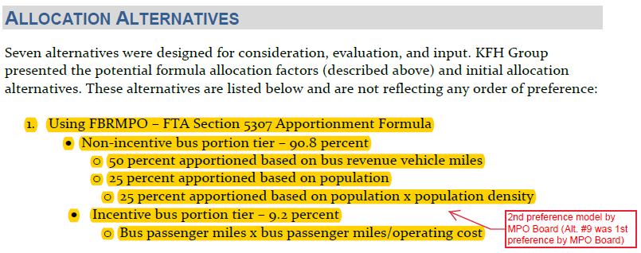
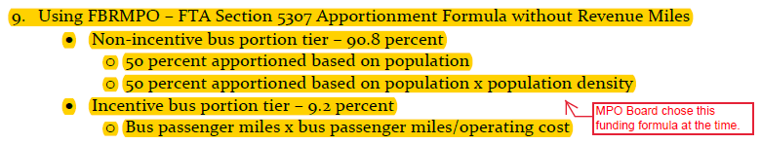

Slide 25
Transit Funding Changes - Details

Slide 27
Transit Funding Changes - Details

Slide 28


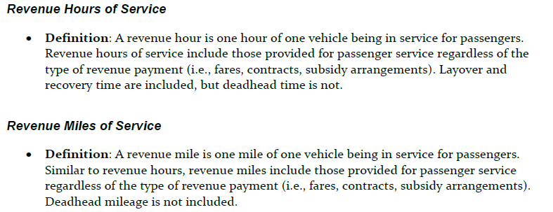

Slide 29
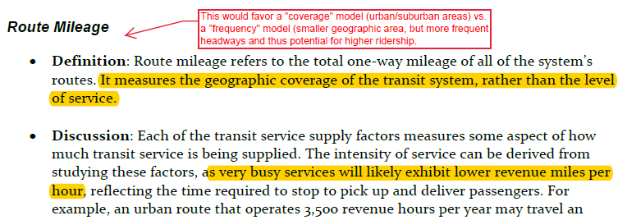
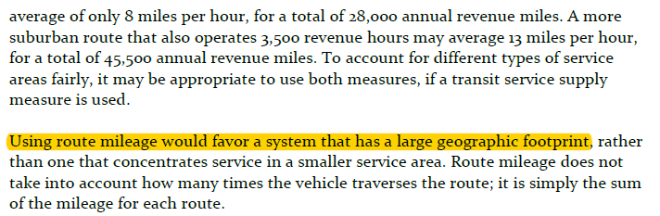
Notes:
Alt. #9 was chosen (FTA Section 5307 Apportionment Formula without Revenue Miles), since more urban systems (i.e. ART and Mountain Mobility) are busier, yet cover a smaller geographic area, thus showing potentially lower per capita Revenue Miles.

Slide 30
